Slide 1

Azure Container Apps The Future of Microservices in Azure??

Slide 2
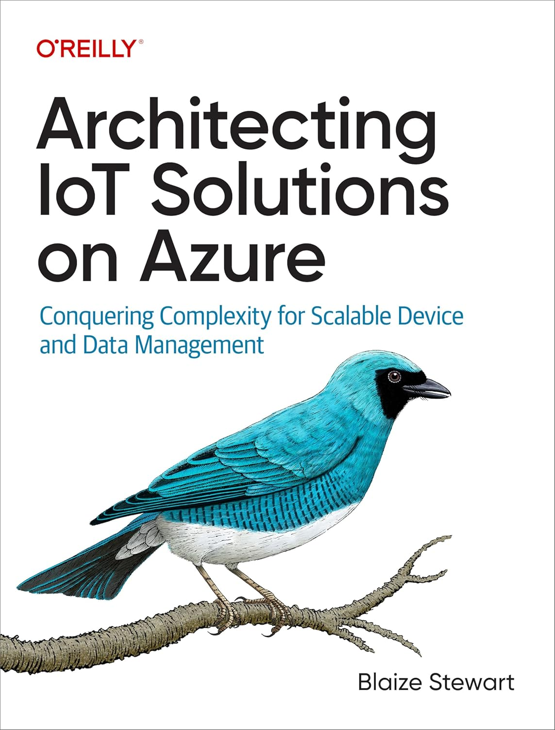





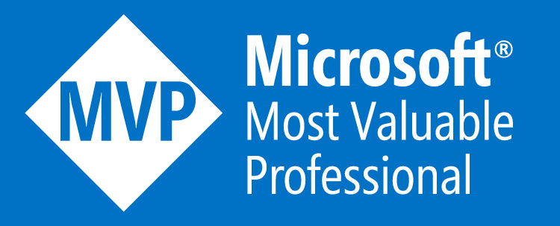
Blaize Stewart
Architect @ Xebia
MicrOsOft MVP
Blaizetech
TechOnfire

Slide 3
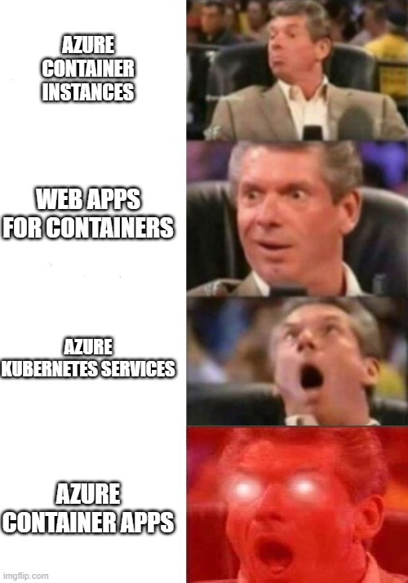
Containers on Azure At Scale
Azure Container Instances
Azure Container Apps
Azure Kubernetes Services
Azure Web Apps for Containers

Slide 4
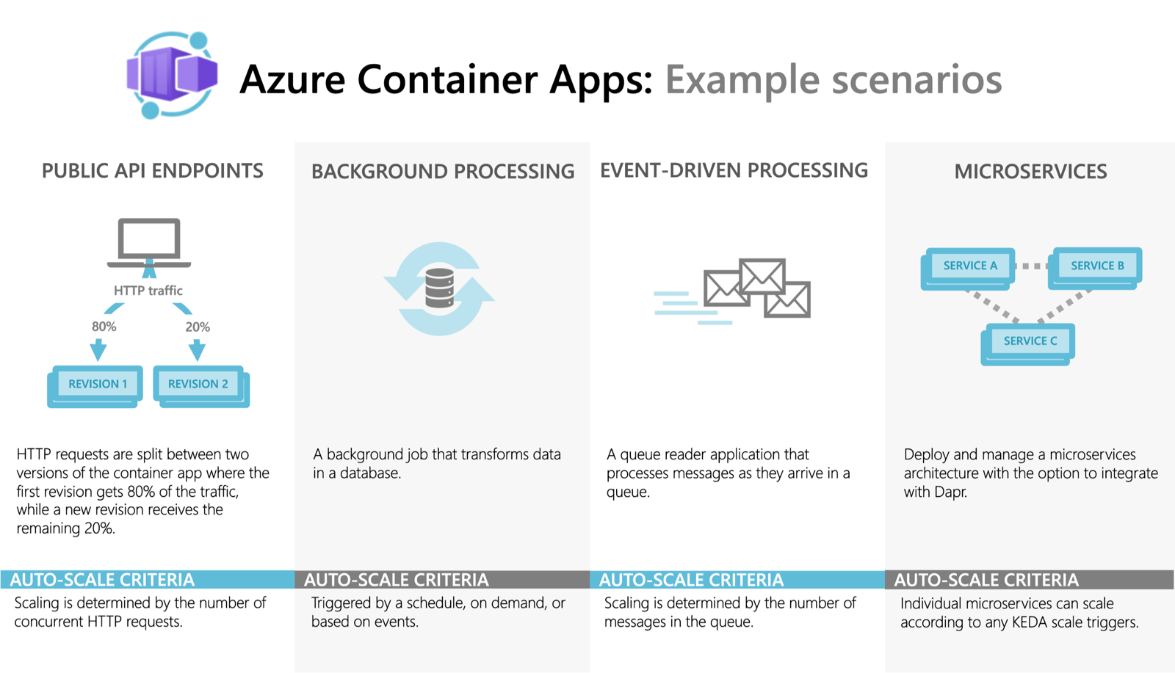
Containers on Azure At Scale

Slide 5

Typical
Kubernetes
App
Ingress (HTTP/HTTPS)
Service (TCP)
Deployment
Pod
Pod
Container
Container
Container
Container
Container
Container

Slide 6
Azure
Container
Apps
Container App Environment
Container App
Revision
Revision
Pod
Pod
Container
Container
Container
Container
Container
Container
Container App
Revision
Revision
Pod
Pod
Container
Container
Container
Container
Container
Container

Slide 7

Deploy Something Awesome to ACA

Slide 8
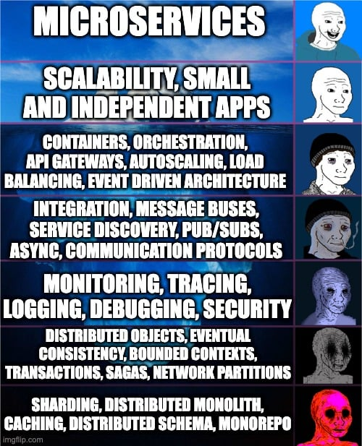
What is a Microservice?
In short, the microservice architectural style is an approach to developing a single application as a suite of small services, each running in its own process and communicating with lightweight mechanisms, often an HTTP resource API. These services are built around business capabilities and independently deployable by fully automated deployment machinery. There is a bare minimum of centralized management of these services, which may be written in different programming languages and use different data storage technologies.
-- James Lewis and Martin Fowler (2014)

Slide 9
MicroService Benefits
Scalability: Enables independent scaling of individual services to optimize resource usage and costs.
Resilience: Isolating failures to a single service prevents system-wide outages, improving overall reliability.
Continuous Deployment: Supports frequent and independent deployments of services without disrupting the entire system.
Efficient Resource Utilization: Services can be scaled up or down based on their specific requirements
Supports Event-Driven Patterns: Seamless integration with messaging systems enables real-time processing and eventual consistency.
Decoupled Dependencies: Services can evolve without being tightly bound to other components, reducing complexity.

Slide 10
MicroService Challenges
Service Discovery: Locating and communicating with dynamic services requires robust discovery mechanisms.
State Management: Maintaining distributed state can lead to consistency and synchronization challenges.
Configuration Management: Managing configurations across multiple services and environments is complex.
Communication and Networking: Network latency, failures, and protocol mismatches increase system complexity.
Monitoring and Observability: Distributed systems make logging, tracing, and performance troubleshooting difficult.
Fault Tolerance: Failures in one service can cascade, affecting the entire system.
Data Management: Handling fragmented data, distributed transactions, and eventual consistency is challenging.
Security: Ensuring secure communication, authentication, and secrets management across services is critical.
Deployment and Testing: Coordinating independent service deployments and testing interdependencies is complicated.

Slide 11
ACA
Scaling
HTTP Traffic: Scale based on the number of concurrent HTTP requests. For example, you can configure your app to add replicas when concurrent requests exceed a specified threshold.
Connections: Scale based on the number of concurrent TCP connections. This is useful for applications that handle non-HTTP protocols.
Custom Metrics via KEDA: Azure Container Apps integrates with Kubernetes Event-Driven Autoscaling (KEDA), enabling scaling based on a wide range of custom metric

Slide 12
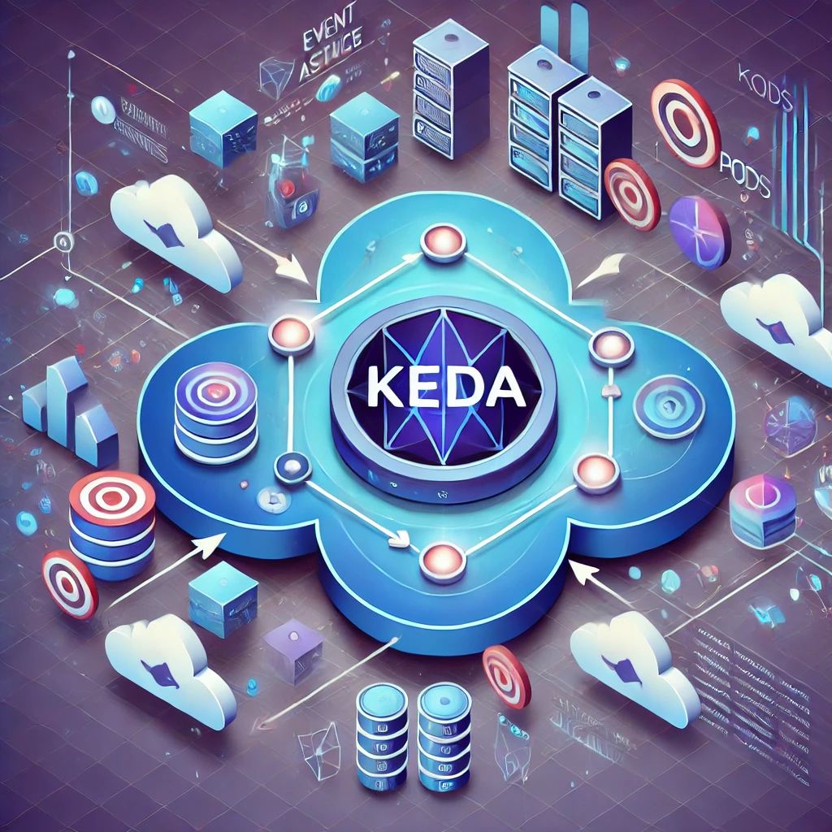
Kubernetes-based
Event-Driven Autoscaling
KEDA enables ACA to scale based on custom events (e.g., queue length, CPU usage, or external triggers).
ACA natively integrates KEDA for simplified autoscaling without Kubernetes complexity.
Supports a wide range of scaling sources, including Azure Event Hubs, Service Bus, and HTTP requests.
Scales to zero when idle, reducing costs for infrequent workloads.
Ideal for background tasks, event-driven workloads, and applications with unpredictable traffic.

Slide 13
SCALING
an APP on ACA

Slide 14
Blue/Green
Deployments
Blue-Green Deployment Strategy:
Two Environments: "Blue" (current) and "Green" (new) are identical setups.
Deploy & Test on Green: New version is deployed to Green, isolated from users.
Traffic Switch: Gradually or instantly route traffic to Green after validation.
Instant Rollback: Quickly revert to Blue if issues arise.
Benefits: Minimizes downtime, reduces risk, ensures high availability.
Ideal for cloud and containerized environments where traffic routing is flexible.

Slide 15
Blue/Green
Deployments
85%
15%
Container App Environment
Container App
Revision
Revision
Pod
Pod
Container
Container
Container
Container
Container
Container

Slide 16
BLUE/GREEN
On ACA

Slide 17
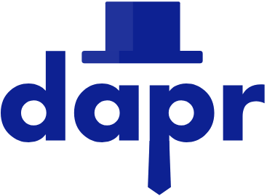
Distributed
Application
Runtime
Open-source runtime: Dapr is a portable, open-source runtime designed to simplify building resilient, microservices-based, distributed applications.
Platform-agnostic: Works across cloud, on-premises, and edge environments, integrating with any programming language or framework.
Microservices toolkit: Provides pre-built building blocks (e.g., service invocation, state management) to streamline common challenges in microservices.
Cloud-native focused: Dapr is built to align with cloud-native best practices, supporting scalability, fault tolerance, and ease of deployment.
Simplifies complex patterns: Implements design patterns like service discovery, pub/sub, and secrets management, so developers can focus more on business logic than infrastructure.

Slide 18
Distributed
Application
Runtime
Service Invocation: Enables secure, reliable, and language-agnostic service-to-service communication in a distributed system.
State Management: Offers APIs for storing and retrieving state across different storage backends, supporting consistency and durability.
Pub/Sub Messaging: Simplifies asynchronous communication using publish-subscribe patterns with various message brokers.
Event Binding: Connects to external systems (e.g., databases, cloud services) via event-driven triggers without writing specific code for integrations.
Observability: Integrates with telemetry systems to provide tracing, logging, and metrics, improving visibility across microservices.
Actor Model: Manages stateful, concurrent operations through virtual actors, beneficial for long-running workflows or distributed state management.
Secrets Management: Provides a secure interface to retrieve and manage secrets from external secret stores.

Slide 19
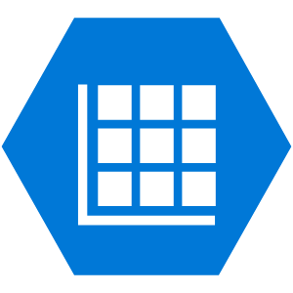
DAPR
Container App Environment
Container App
Container App
Revision
Revision
Pod
Pod
Container
Container
Side Car
Side Car
Ingress
DAPR
State
(Azure Tables)

Slide 20
DAPR
on
ACA

Slide 21
When to Use Container Apps
Microservices and Event-Driven Architectures: ACA is ideal for deploying microservices or event-driven workloads that need scalability and communication through Dapr.
Stateless or Stateful Applications: ACA supports both types of applications, allowing for session data persistence or entirely stateless services.
Dynamic Scaling Needs: ACA automatically scales based on events, HTTP requests, or queue-based triggers without manual intervention.
Lightweight Application Hosting: ACA is perfect for small to medium applications or proofs of concept where a full Kubernetes cluster is unnecessary.
Managed Infrastructure. If you want a fully managed platform that abstracts away Kubernetes complexity but retains its scalability and orchestration benefits.
Integration with Azure Ecosystem: ACA easily integrates with Azure services like Event Hub, Azure Functions, and Azure Monitor.

Slide 22
When NOT to
Use Container Apps
Complex Orchestration Requirements: Avoid ACA if your application requires advanced orchestration patterns or dependencies that are better handled by Azure Kubernetes Service (AKS).
High Customization Needs: If you need fine-grained control over networking, scaling policies, or other infrastructure, Azure Container Apps may not meet your needs.
Legacy Monolithic Applications: Not ideal for large monolithic applications that are not designed to work with containerized or cloud-native patterns.
High Network Dependency: If your workload requires low-level network configurations or specific ingress/egress setups, consider AKS or Virtual Machines.
Very Large-Scale Systems: For extensive systems with thousands of containers, AKS might be more appropriate due to scalability and resource management needs.
Specific Compliance or Security Needs: If you need extremely strict compliance or isolation policies, a more customizable platform like AKS might be required.

Slide 23
ACA/DAPR
Microservices
Challenge/Benefit | ACA | DAPR
Scalability | ✅
Resilience | ✅
Continuous Deployment | ✅
Efficient Resource Util | ✅
Event-Driven Patterns |  | ✅
Decoupled Dependencies | ✅ | ✅
Service Discovery | ✅ | ✅
State Management |  | ✅
Config Management |  | ✅
Data Management |  | ✅
Networking | ✅
Monitoring | ✅ | ✅
Fault Tolerance | ✅ | ✅
Security | ✅ | ✅
Testing | ✅

Slide 24
Questions??
Blaize Stewart
Architect @ Xebia
MicrOsOft MVP
Blaizetech
TechOnfire

Slide 25

Session Survey
Your feedback is very important to us
Please take a moment to complete the session survey found in the mobile app
Use the QR code or search for “Converge360 Events” in your app store
Find this session on the Agenda tab
Click “Session Evaluation”
Thank you!

